Slide 1
Spring 2021
DATS 501 Fundamentals of Data Science
Cumhur Baştürk
basturkc.academic@gmail.com
Hasan Demirtaş
hasan.demirtas@yeditepe.edu.tr
hdemirtas.academic@gmail.com

Slide 2

Ensemble Learning

Slide 3
Suppose that:
You ask a complex question to thousands of random people,
then aggregate their answers.
In many cases you will find that this aggregated answer is better than an expert’s answer.
This is called the wisdom of the crowd.
Similarly,
If you aggregate the predictions of a group of predictors (such as classifiers or regressors), you will often get better predictions than with the best individual predictor.
A group of predictors is called an ensemble.
This technique is called Ensemble Learning.
An Ensemble Learning algorithm is called an Ensemble method.
In other words, an ensemble method is a technique that combines the predictions from multiple machine learning algorithms together to make more accurate predictions than any individual model.

Slide 4
There are 3 common ensemble methods:
Bagging (Bootstrap Aggregation)
Boosting
Stacking
BAGGING
Before we get to Bagging, let’s take a quick look at what «bootstrap method» is.
- The bootstrap method is a resampling technique used to estimate statistics (like mean, variance) on a population by sampling a dataset with replacement.
- The bootstrap resampling method is used for estimating the skill of machine learning models on unseen data. How? (Out-Of-Bag concept)

Slide 5
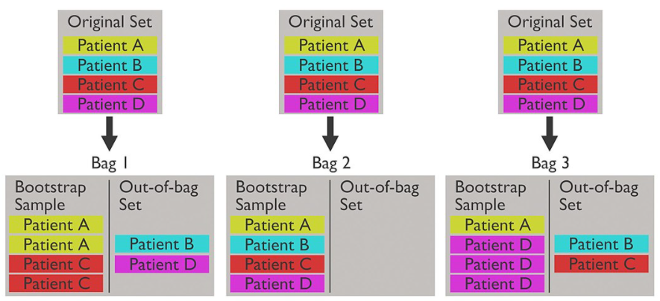
When bootstrap method is performed, two independent sets are created. One set, the bootstrap sample, is the data chosen to be "in-the-bag" by sampling with replacement. The out-of-bag set is all data not chosen in the sampling process.
An illustration of the bagging process, explicitly showing the out-of-bag set. A medical context is provided for ease of understanding.

Slide 6
- Bootstrap Aggregation is the application of the Bootstrap procedure to a high-variance machine learning algorithm, typically decision trees which use CART algorithm.
- Decision trees are sensitive to the specific data on which they are trained. If the training data is changed (e.g. a tree is trained on a subset of the training data) the resulting decision tree can be quite different and in turn the predictions can be quite different.
Let’s assume we have a sample dataset of 1000 instances (x) and we are using the CART algorithm. Bagging of the CART algorithm would work as follows:
Create many (e.g. 100) random sub-samples of our dataset with replacement.
Train a CART model on each sample.
Given a new dataset, calculate the average prediction from each model.
! Do not forget that decision trees use Greedy Algorithm, therefor there should be most likely overfitting on used machine learning models. But by increasing the number of trees on run after run until the accuracy begins to stop showing improvement (e.g. on a cross validation test harness), model will not overfit the training data.

Slide 7
We may summarize the bagging process as:
Choose a number of bootstrap samples to perform ⁽¹⁾
Choose a sample size ⁽²⁾
For each bootstrap sample
Draw a sample with replacement with the chosen size
Fit a model on the data sample
Estimate the skill of the model on the out-of-bag sample.
Calculate the mean of the sample of model skill estimates.
⁽¹⁾ In machine learning, it is common to use a sample size that is the same as the original dataset.
⁽²⁾ A minimum might be 20 or 30 repetitions. Ideally, the sample of estimates would be as large as possible given the time resources, with hundreds or thousands of repeats.
Let's zoom in out-of-bag error whose general calculation is as follows:
Find all models (e.g. trees) that are not trained by the OOB instance.
Take the majority vote of these models' result for the OOB instance, compared to the true value of the OOB instance.
Compile the OOB error for all instances in the OOB dataset.

Slide 8
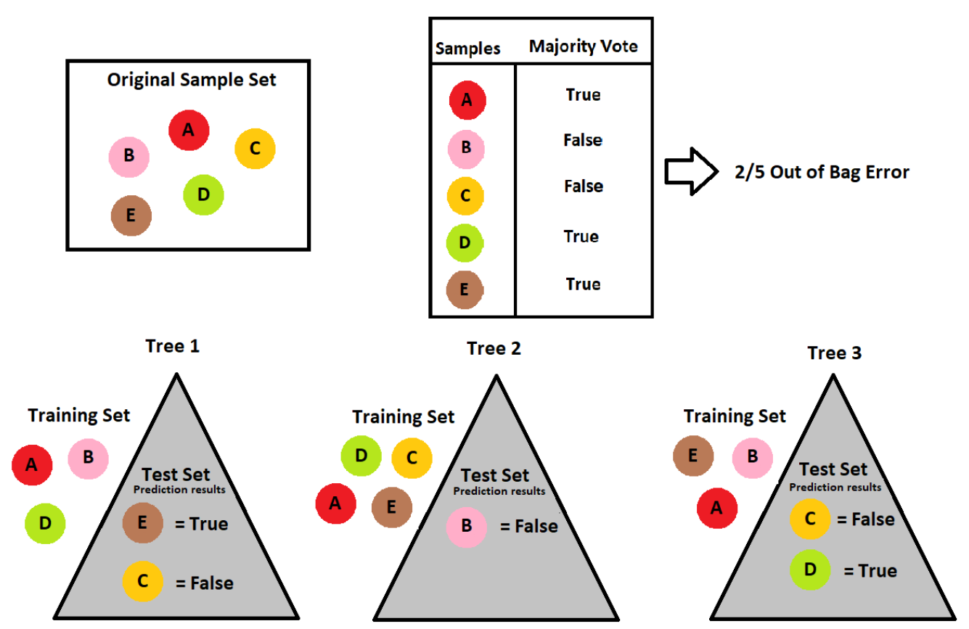

Slide 9
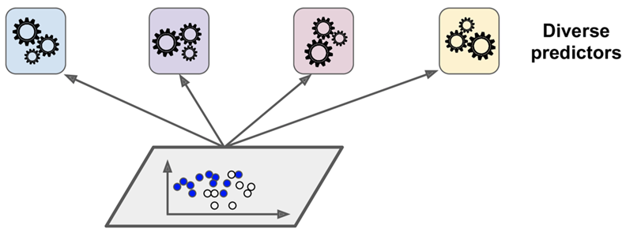
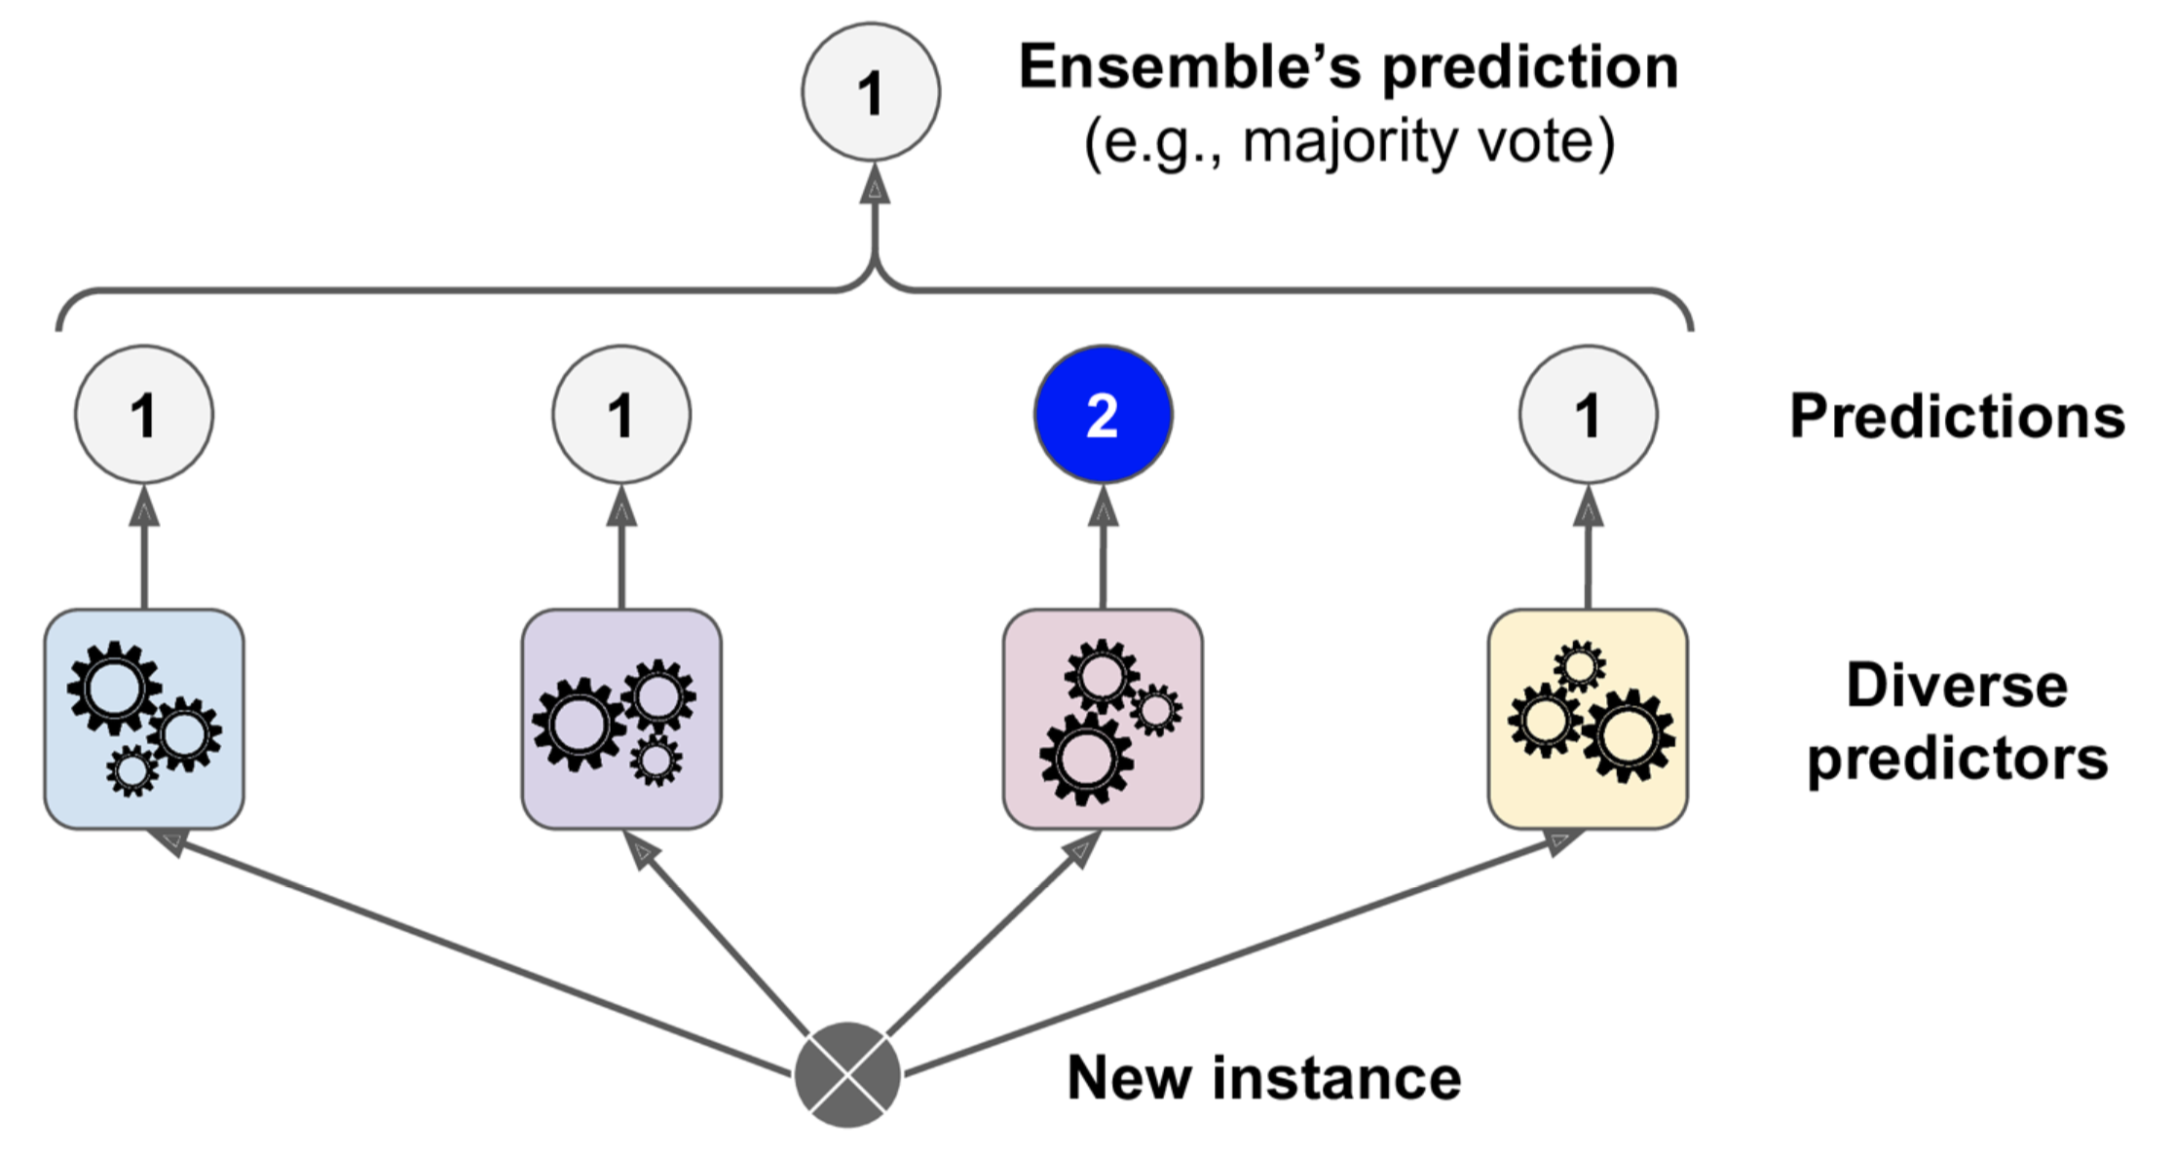
Voting is used to make weak-learnerS a strong-learner.
Majority-Voting
Hard Voting
Soft Voting
Hard voting
A very simple way to create an even better classifier is to aggregate the predictions of each classifier and predict the class that gets the most votes.
Trained a few classifiers, each one achieving about let’s say 80% accuracy.
Logistic Regression
SVM Classifier
k-NN
Other

Slide 10
TİP:
Ensemble methods work best with the predictors that are as independent from one another as possible.
One way to get diverse classifiers is to train them using very different algorithms. This increases the chance that they will make very different types of errors, improving the ensemble's accuracy.
Soft voting
If all classifiers are able to estimate class probabilities (i.e., not only the class (0 or 1) but also the probability of this class %70->class 0, %83->class 1), then averaged over all the individual classifiers.
It often achieves higher performance than hard voting because it gives more weight to highly confident votes.

Slide 11
Random Forests

Slide 12
Random Forests are an improvement over bagged decision trees.
A problem with decision trees like CART is that they are greedy. They choose which variable to split on using a greedy algorithm that minimizes error. As such, even with Bagging, the decision trees can have a lot of structural similarities and in turn have high correlation in their predictions.
Combining predictions from multiple models in ensembles works better if the predictions from the sub-models are uncorrelated or at best weakly correlated.
Random forest changes the algorithm for the way that the sub-trees are learned so that the resulting predictions from all of the subtrees have less correlation.
It is a simple tweak. In CART, when selecting a split point, the learning algorithm is allowed to look through all variables and all variable values in order to select the most optimal split-point. The random forest algorithm changes this procedure so that the learning algorithm is limited to a random sample of features of which to search. It searches for the best feature among a random subset of features.

Slide 13
Extremely Randomized Trees (Extra - Trees)
Extra Trees Algorithm makes trees even more random by also using random thresholds for each feature rather than searching for the best possible thresholds (Remember the impurity and gini score! No need to choose the optimum split instead choose it randomly. For extra information:
I mean randomness goes one step further in the way splits are computed. As in random forests, a random subset of candidate features is used, but instead of looking for the most discriminative thresholds, thresholds are drawn at random for each candidate feature and the best of these randomly-generated thresholds is picked as the splitting rule.
This usually allows to reduce the variance of the model a bit more, at the expense of a slightly greater increase in bias.
Paper
*Both Random Forest and Extra Trees algorithms give features importances (feature_importances_)

Slide 14
BOOSTING
Ensemble method that can combine several weak learners into a strong learner.
The general idea is to train predictors sequentially, each trying to correct its predecessor.
Most popular ones are AdaBoost (short for Adaptive Boosting) and Gradient Boosting.
AdaBoost Algorithm
Works sequentially of the predictors.
Assigns weights to instances in terms of incorrectly classified instances by the predecessor.
Works on the same principle as boosting, but there is a slight difference. (we’ll see now.)
How AdaBoost Works?
Let's see how boosting works first...

Slide 15
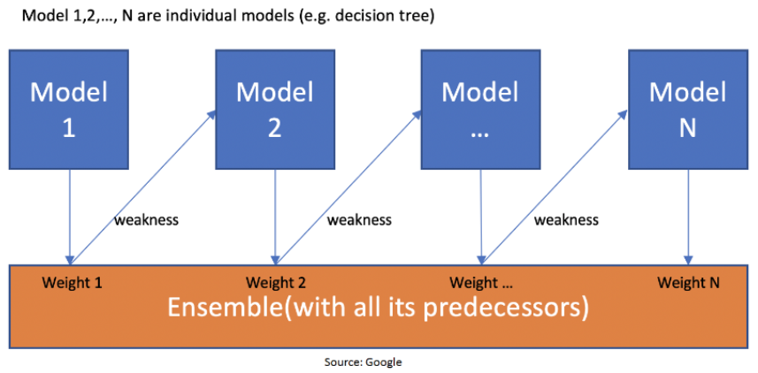
This figure shows:
First model is made and the errors from the first model are noted by the algorithm
The record which is incorrectly classified is given as the input for the next model.
This process is repeated until the specified condition is met.
As you can see in the figure, there are N number of individual models made by taking the errors from the previous model.
This is how boosting works...

Slide 16
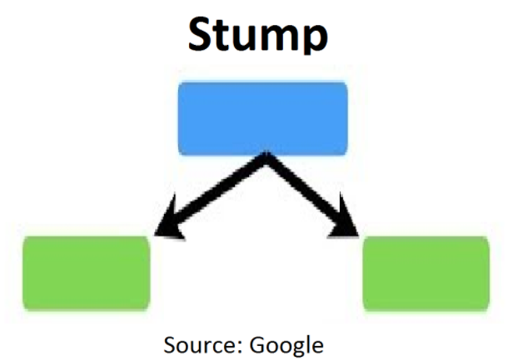
In Random Forest, proper trees consist of a start node with several leaves nodes.
Contrarily AdaBoost Algorithm let the trees only make a node with two leaves, thus, name TREE changes to STUMP.
Figure shows one node with only two leaves
The order of stumps is very important in AdaBoost. The error of the first stump influences how the other stump is made. Let’s understand this with an example.

Slide 17
Row Number | Feature 1 | Feature 2 | Feature 3 | Output | Sample Weight
1 |  |  |  | Yes | 1/5
2 |  |  |  | Yes | 1/5
3 |  |  |  | No | 1/5
4 |  |  |  | No | 1/5
5 |  |  |  | Yes | 1/5
Figure shows:
A sample dataset that consists of only three features, and the output is in categorical form.
The image shows the actual representation of the dataset.
As the output is in binary/categorical form, it becomes a classification problem.
In real life, the dataset can have any number of records and features in it.
Let us consider 5 datasets for explanation purposes.
The output is in categorical form and, here it’s Yes or No.
All these records will get a sample weight.
To assign some sample weight, the formula used is
W=1/N ,N is the number of records.
In this dataset, there are only 5 records, so the sample weight becomes 1/5 initially.
Every record gets the same weight. In this case, it’s 1/5.

Slide 18
Step 1 – Creating First Base Learner
The algorithm takes the first feature, i.e., feature 1, and creates the first stump f1.
It will create the same number of stumps as the number of features. Here, it will create 3 stumps as there are only 3 features in this dataset.
From all these stumps it will create three decision trees (stumps).
Out of these 3 models, the algorithm selects only one.
For selecting a base learner, there are two properties, those are, Gini and Entropy. We must calculate Gini or Entropy the same way it is calculated for decision trees.
The stump that has the least gini index will be the first base learner.
In the below figure, all the 3 stumps can be made with 3 features. The number below the leaves represents the correctly and incorrectly classified records. By using these records, the Gini or entropy index is calculated. The stump that has the least entropy or Gini will be selected for the base learner. Let’s assume that the entropy index is the least for stump 1. So, let’s take stump 1, i.e., feature 1 as our first base learner.

Slide 19
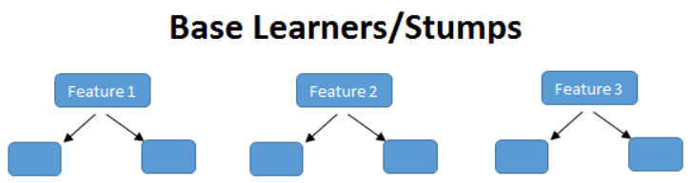
2,1
2,0
3,0
0,2
2,1
1,1
Row Number | Feature 1 | Feature 2 | Feature 3 | Output | Sample Weight
1 |  |  |  | Yes | 1/5
2 |  |  |  | Yes | 1/5
3 |  |  |  | No | 1/5
4 |  |  |  | No | 1/5
5 |  |  |  | Yes | 1/5
Here, feature (f1) has classified 2 records correctly and 1 incorrectly. The row in the figure that is marked red is incorrectly classified. For this, we will be calculating the total error.

Slide 20
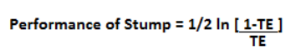
Step 2 – Calculating the Total Error (TE)
The total error is the sum of all the errors in the classified record for sample weights.
In our case, there is only 1 error, so Total Error (TE) = 1/5.
Step 3 – Calculating Performance of Stump
ln is natural log and TE is Total Error.
In our case, TE is 1/5.
By putting the value of total error in the above formula and after solving, we get the value for the performance of Stump as 0.693. You must be wondering why its necessary to calculate the TE and performance of stump? The answer is, we must update the sample weight before proceeding for the next model or stage because if the same weight is applied, we receive the output from the first model.
In boosting, only the wrong records/incorrectly classified records got more preference than the correctly classified records. Thus, only the wrong records from the decision tree/stump are passed on to another stump.
While in AdaBoost, both records were allowed to pass, the wrong records are repeated more than the correct ones. We must increase the weight for the wrongly classified records and decrease the weight for the correctly classified records. In the next step, we will be updating the weights based on the performance of the stump.

Slide 21
Step 4 – Updating Weights
For incorrectly classified records the formula is:
New Sample Weight = Sample Weight * e^(Performance)
In our case Sample weight = 1/5 so,
1/5 * e^ (0.693) = 0.399
And for correctly classified records, we use the same formula with a negative sign with performance, so that the weight for correctly classified records will reduce compared to the incorrect classified ones. The formula is:
New Sample Weight = Sample Weight * e^- (Performance)
Putting the values, 1/5 * e^-(0.693) = 0.100
Let’s check our table:

Slide 22
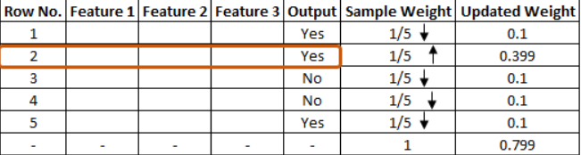
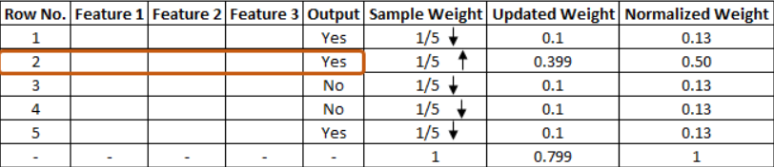
The updated weight for all the records can be seen in the figure.
As is known, the total sum of all the weights should be 1.
But in this case, one can see that the total updated weight of all the records is not 1, it’s 0.799.
To make the total sum 1, one must divide every updated weight by the total sum of updated weight. For example, if our updated weight is 0.399 and we divide this by 0.799, i.e. 0.399/0.799=0.50.
0.50 can be known as the normalized weight. In the below figure, we can see all the normalized weight and their sum is approximately 1.

Slide 23
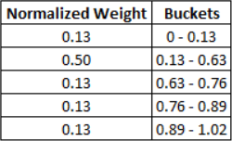
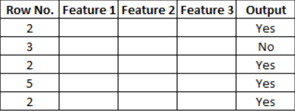
Step 5 – Creating New Dataset
Now, it’s time to create a new dataset from our previous one.
In the new dataset, the frequency of incorrectly classified records will be more than the correct ones.
While considering these normalized weights, we have to create a new dataset and that dataset is based on normalized weights.
It will probably select the wrong records for training purposes.
That will be the second decision tree/stump.
To make a new dataset based on normalized weight, the algorithm will divide it into buckets.
So, our first bucket is from 0 – 0.13, second will be from 0.13 – 0.63(0.13+0.50), third will be from
0.63 – 0.76(0.63+0.13), and so on. After this the algorithm will run 5 iterations to select different records from the older dataset. Suppose, in 1st iteration, the algorithm will take a random value 0.46, then it will go and see in which bucket that value falls and selects that records in the new dataset, then again it will select a random value and see in which bucket it is and select that record for the new dataset and the same process is repeated for 5 times.
There is a high probability for the wrong records to get selected several times. This will be the new dataset. It can be seen in the below image that row number 2 has been selected multiple times from the older dataset as that row is incorrectly classified in the previous dataset.

Slide 24
AdaBoost w/ Python
#using scikit-learn library
from sklearn.ensemble import AdaBoostClassifier
from sklearn.metrics import accuracy_score
ada_clf = AdaBoostClassifier()
y_pred= ada_clf.fit(X_train, y_train).predict(X_test)
accuracy_score(y_test, y_pred)

Slide 25
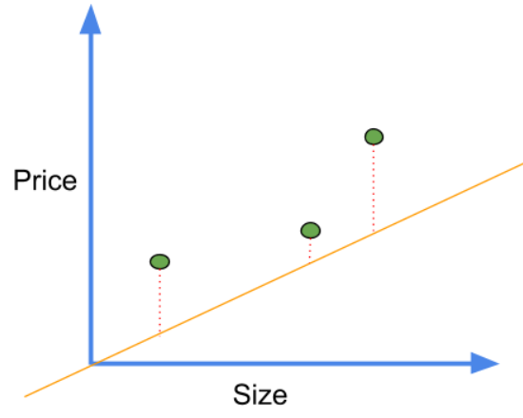
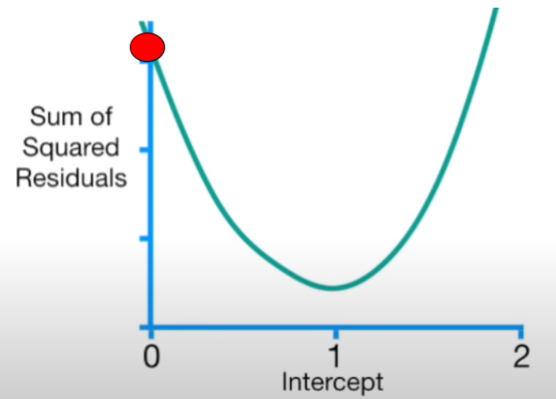
Gradient Boosting Algorithm
Re-defines boosting as a numerical optimisation problem where the objective is to minimise the loss function of the model by adding weak learners using gradient descent.
! Remember with an example: Gradient descent is an iterative process that finds the minima of a function.
The gradient descent is provided with a random guess for the value of the intercept. In our case, we take a random guess of zero, so the equation becomes
Predicted value = intercept + slope * x
The predicted values for the above can be calculated like this.
Predicted value = 0 + 0.64 * 0.5=0.32
Area | Price(millions)
0.5 | 1.4
2.3 | 1.9
2.9 | 3.2
The primary task of Gradient Descent is to find the minimum of this cost function. To find the minimum point, we find its derivatives with respect to intercept. So the equation of this cost function is given by
f(intercept) = (1.4-(intercept+ 0.64 * 0.5))^2
+ (1.9-(intercept+0.64 * 2.3))^2
+ (3.2-(intercept+0.64 * 2.9))^2
The derivative of this function with respect to intercept is given by:
Derivative= - 2 (1.4-(intercept+0.64 * 0.5))
+ -2 (1.9-(intercept+0.64 * 2.3))
+ -2 (3.2-(intercept+0.64 * 2.9))
Let us put the value of intercept=0 to find the value of the next intercept Derivative= - 2 (1.4-(0+0.64 * 0.5))
+ -2 (1.9-(0+0.64 * 2.3))
+ -2 (3.2-(0+0.64 * 2.9))
= -5.7
Gradient descent subtracts the step size from the current value of intercept to get the new value of intercept. This step size is calculated by multiplying the derivative which is -5.7 here to a small number called the learning rate.

Slide 26
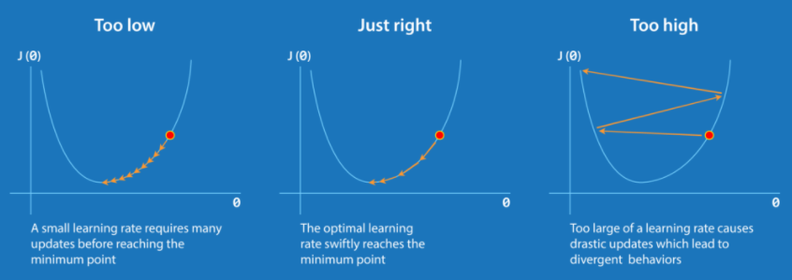
In this case, we take the learning rate 0.1
Step size= -5.7*0.1
New intercept = old intercept-step size
= 0-(-0.57)=0.57
Let us now put the new intercept in the derivative function
d sum of squared error /d(intercept)= -2 (1.4-(0.57+0.64 * 0.5))
+ -2 (1.9-(0.57+0.64 * 2.3))
+ -2 (3.2-(0.57+0.64 * 2.9))
= -2.3
Now calculate the next step size
Step size= -2.3*0.1
New intercept = old intercept-step size
= 0.57-(-0.23)=0.8
Again let us now put the new intercept in the derivative function
d sum of squared error /d(intercept)= - 2 (1.4-(0.8+0.64 * 0.5))
+ -2 (1.9-(0.8+0.64 * 2.3))
+ -2 (3.2-(0.8+0.64 * 2.9))
= -0.9
Step size= -0.9*0.1
New intercept= old intercept-step size
= 0.8-(-0.09)
= 0.89

Slide 27
Gradient boosting is a stage-wise additive model that generates learners during the learning process (i.e., trees are added one at a time, and existing trees in the model are not changed).
The contribution of the weak learner to the ensemble is based on the gradient descent optimisation process.
The calculated contribution of each tree is based on minimising the overall error of the strong learner.
It tries to fit the new predictor to the loss function (e.g. residuals) made by the previous predictor.

Slide 28
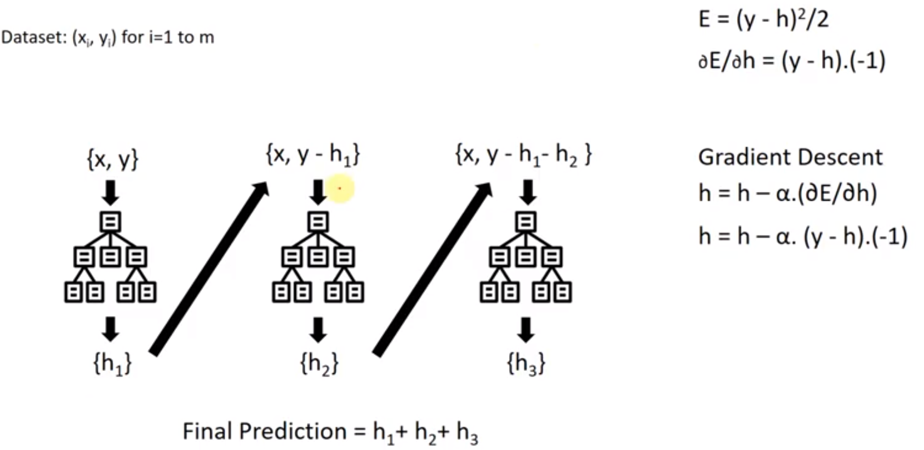
Remember random forest algorithm.
We separate data set to n different sub data sets and create different decision trees for these sub data sets.
In contrast, data set remains same in GBM.
We will create a decision tree, we will feed decision tree algorithm same data set but we will update each instance’s label value as its actual value minus its prediction.
You might think sequential decision trees in gradient boosting.

Slide 29
Understand Gradient Boosting Algorithm with example
Gradient Boosting is used for regression as well as classification tasks.
Following is a sample from a random dataset where we have to predict the weight of an individual, given the height, favourite colour, and gender of a person.
Height(m) | Favourite Color | Gender | Weight(kg)
1.6 | Blue | Male | 88
1.6 | Green | Female | 76
1.5 | Blue | Female | 56
1.8 | Red | Male | 73
It builds a first learner to predict the observations in the training dataset. This learner is a basic learner. Usually for simplicity, we take an average of all the target variables and assume that to be predicted value in case of Regression as shown below.
Height(m) | Favourite Color | Gender | Weight(kg) | Prediction 1
1.6 | Blue | Male | 88 | 73.5
1.6 | Green | Female | 76 | 73.5
1.5 | Blue | Female | 56 | 73.5
1.8 | Red | Male | 73 | 73.5
Then, it calculates the loss (i.e., the value between the first learner’s outcomes and the actual values).

Slide 30
Height(m) | Favourite Color | Gender | Weight(kg) | Prediction 1 | Residuals(1) (New Target)
1.6 | Blue | Male | 88 | 73.5 | 14.5
1.6 | Green | Female | 76 | 73.5 | 2.5
1.5 | Blue | Female | 56 | 73.5 | -17.5
1.8 | Red | Male | 73 | 73.5 | -0.5
It will build a second learner that is fitted/trained on the residual error usually known as pseudo-residual produced by the first learner to predict the loss after the first step and continue to do so until it reaches a threshold (i.e., residuals are zero).
Now calculate the new residuals using the new decision tree. Also, we use a learning rate of 0.1 to avoid big jumps.
New residual value for first sample =(88-73.5+0.1(14.5))=13.05. In a similar manner calculate the rest of the entries.
Height(m) | Favourite Color | Gender | Weight(kg) | Residuals(2) (New Target)
1.6 | Blue | Male | 88 | 13.05
1.6 | Green | Female | 76 | 2.25
1.5 | Blue | Female | 56 | -15.75
1.8 | Red | Male | 73 | -0.45
. . .

Slide 31
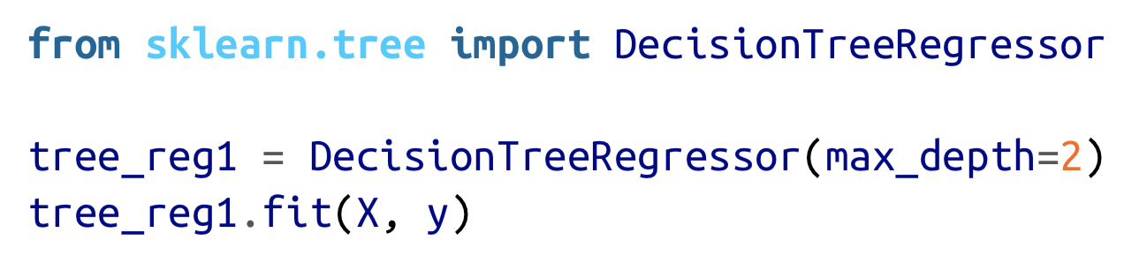
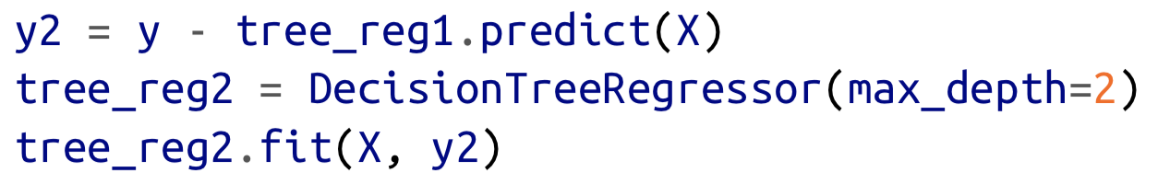
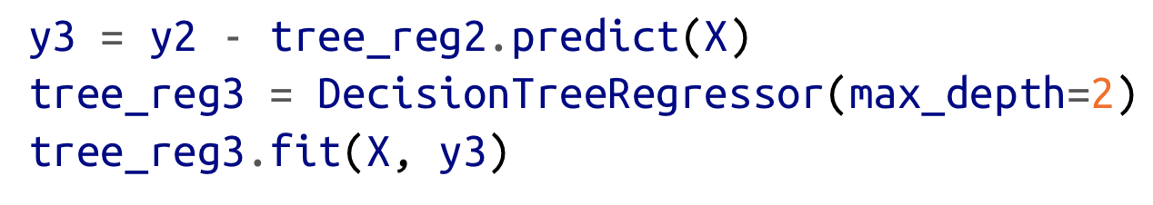

Gradient Boosting w/ Python

Slide 32
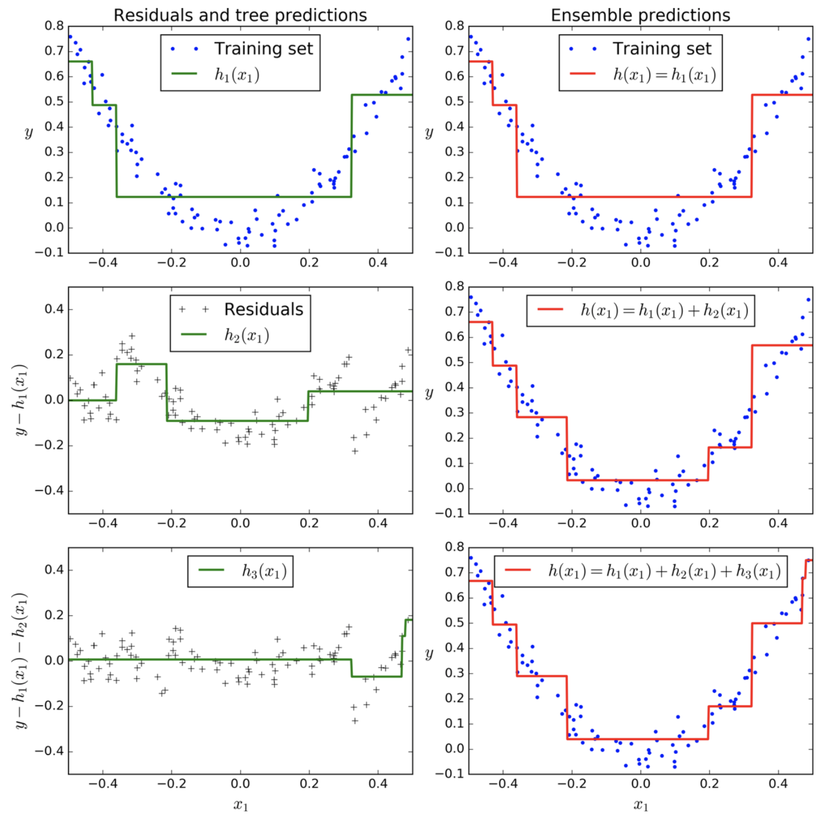

Slide 33
Stacking(Stacked Generalization)

Slide 34
Stacking is based on a simple idea: instead of using trivial functions (such as hard voting) to aggregate the predictions of all predictors in an ensemble, why don’t we train a model to perform this aggregation? We can understand the process in the following steps
We split the data into two parts: a training set and test set. The training data is further split into K-folds just like K-fold cross-validation.
A base model(e.g k-NN) is fitted on the K-1 parts and predictions are made for the Kth part.
This process is iterated until every fold has been predicted.
The base model is then fitted on the whole train data set to calculate its performance on the test set.
We repeat the last 3 steps for other base models.(e.g SVM,decision tree,neural network)
Predictions from the train set are used as features for the second level model.
Second level model is used to make a prediction on the test set.

Slide 35
